Slide 1
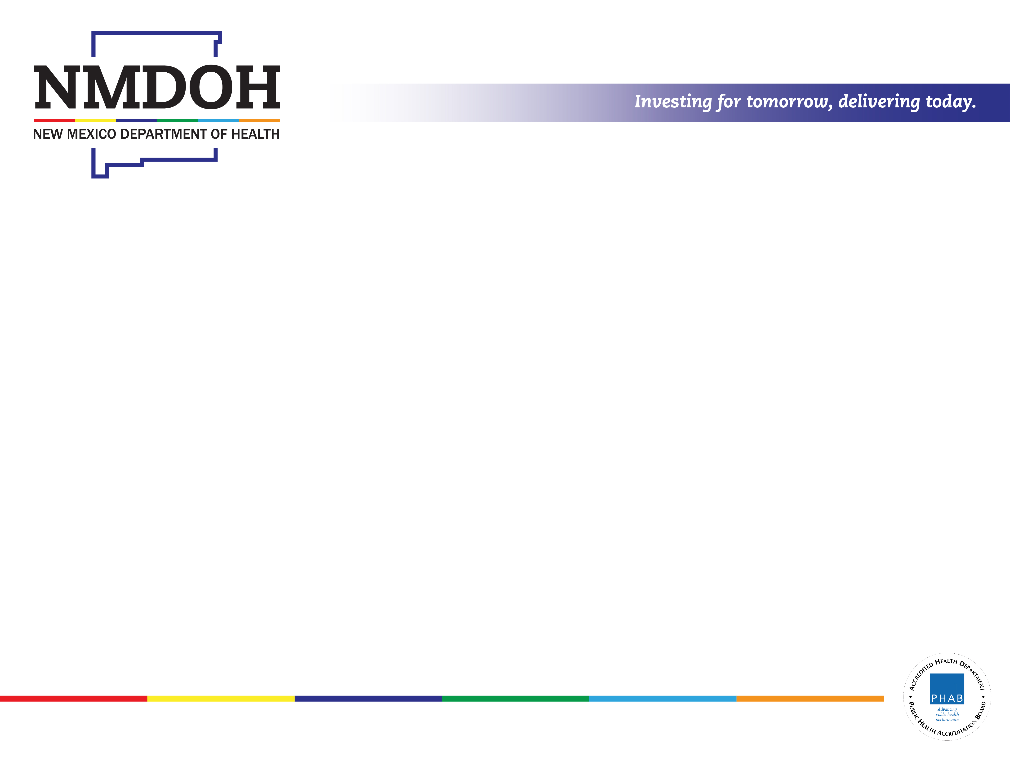
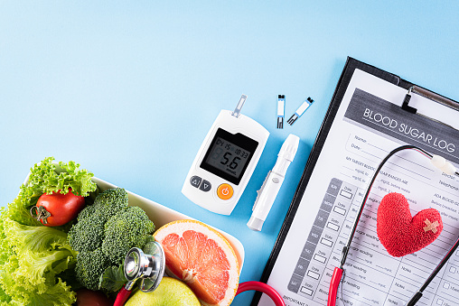
Diabetes and Pre-diabetes
in New Mexico
Diabetes Prevention and Control Program
Population and Community Health Bureau
Public Health Division
NM Department of Health
Wayne A. Honey, MPH
December 2, 2022

Slide 2
All DM
Diagnosed DM
Notes:
Trend of Diagnosed Diabetes, NM and U.S., and all Diabetes … age-adjusted to 2000 U.S. Census. Diagnosed Diabetes adjusted by NHANES undiagnosed estimates for estimate of total diabetes prevalence among NM adults. 2021 All DM estimate is based on 2020 NM population estimates (2021 population estimates not yet available.
Sources: NM BRFSS; CDC National BRFSS; 2013-2016 NHANES.

Slide 3
Percentage (%)
Notes:
Age-adjusted estimates of the prevalence of various health conditions by diagnosed diabetes.
The age-adjusted prevalence of each conditions was statistically significantly higher among adults with diagnosed diabetes than among adults without diagnosed diabetes.
Source: NM BRFSS, 2018-2020 combined years.

Slide 4
Note Scale
All Pre-DM
Diagnosed Pre-DM
Notes:
Trend of Diagnosed Pre-diabetes, NM and U.S., and all Diabetes … age-adjusted to 2000 U.S. Census. Diagnosed Pre-diabetes adjusted by NHANES undiagnosed estimates for estimate of total Pre-diabetes prevalence among NM adults.
Prediabetes module included in select states, only.
Sources: NM BRFSS; CDC National BRFSS; 2013-2016 NHANES.

Slide 5
Percentage (%)
*HBP 2019 & 2021
Notes:
Age-adjusted estimates of the prevalence of various health conditions by diagnosed prediabetes.
The age-adjusted prevalence of disability, Fair/Poor health, CVD, high blood pressure, and diagnosed depression, were statistically significantly higher among adults with diagnosed prediabetes than among adults without diagnosed prediabetes.
Source: NM BRFSS, 2019-2021 combined years.

Slide 6

Blood Glucose Testing in Previous Three Years - 2020
BG Testing Recommended at least every three years for everyone age 45+ or if less than age 45 and with specific health conditions. BG testing within previous 3 years.
Age 45+ | 32.8% Not tested in previous 3 years
Age 45+ with health care coverage | 31.8% Not tested in previous 3 years
Age 45+ without health care coverage | 43.5% Not tested in previous 3 years
Less than Age 45 and with specific health condition/status
Obese (BMI 30.0 or more) | 44.9% Not tested in previous 3 years
Ever High Blood Pressure | 48.5% Not tested in previous 3 years
CVD … History of MI, CHD, and/or Stroke | 41.1% Not tested in previous 3 years
No leisure-time physical activity | 59.3% Not tested in previous 3 years
Notes:
Early identification of insulin resistance/pre-diabetes is crucial in that it presents an opportunity to delay or even prevent development of diabetes and serious secondary conditions.
All adults aged 45 or older should be tested at least every three years. In NM in the year 2020, 32.8% of adults aged 45+ had not been tested in the previous 3 years.
43.5% of those aged 45+ who did not have health care coverage had not been screened in the previous three years.
Adults less than age 45 who are obese, have ever been told they had high blood pressure, have history of CVD, or report no leisure-time physical activity, should be tested at least every three years.
44.9% of adults aged 18-<45 and obese had not been tested.
48.5% of adults aged 18-<45 and with history of high blood pressure had not been tested.
41.1% of adults aged 18-<45 and with history of CVD had not been tested.
59.3% of adults aged 18-<45 and reporting no leisure-time PA had not been tested.
There is much room for improvement in testing.

Slide 7
Blood Glucose Testing in Previous Three Years - 2021
BG Testing Recommended at least every three years for everyone age 45+ or if less than age 45 and with specific health conditions. BG testing within previous 3 years.
Age 45+ | 33.5% Not tested in previous 3 years
Age 45+ with health care coverage | 32.2% Not tested in previous 3 years
Age 45+ without health care coverage | 57.8% Not tested in previous 3 years
Less than Age 45 and with specific health condition/status
Obese (BMI 30.0 or more) | 50.6% Not tested in previous 3 years
Ever High Blood Pressure | 50.6% Not tested in previous 3 years
CVD … History of MI, CHD, and/or Stroke | 24.8% Not tested in previous 3 years
No leisure-time physical activity | 58.1% Not tested in previous 3 years
Notes:
Early identification of insulin resistance/pre-diabetes is crucial in that it presents an opportunity to delay or even prevent development of diabetes and serious secondary conditions.
All adults aged 45 or older should be tested at least every three years. In NM in the year 2021, 33.5% of adults aged 45+ had not been tested in the previous 3 years.
57.8% of those aged 45+ who did not have health care coverage had not been screened in the previous three years.
Adults less than age 45 who are obese, have ever been told they had high blood pressure, have history of CVD, or report no leisure-time physical activity, should be tested at least every three years.
50.6% of adults aged 18-<45 and obese had not been tested.
50.6% of adults aged 18-<45 and with history of high blood pressure had not been tested.
24.8% of adults aged 18-<45 and with history of CVD had not been tested.
58.1% of adults aged 18-<45 and reporting no leisure-time PA had not been tested.
There is much room for improvement in testing which may explain an important portion of the discrepancy between estimates of the true prevalence of prediabetes and diagnosed prediabetes.

Slide 8
Sources of data available to you …
NM-IBIS: https://ibis.doh.nm.gov
  Strengths …
    NM-specific data … Deaths by condition, Hospitalization by condition, Behavioral Risk Factor Surveillance System, American Community Survey, population estimates
    Most current, usually no more than two years behind, some data sources only one year behind.
    Easy to produce tables and maps
    Indicator Reports on many topics providing interpretation
  Weaknesses …
    Limited ability to present associations between conditions
    IBIS provides no interpretation of tables and maps

Slide 9
Sources of data available to you …
CDC Diabetes: https://www.cdc.gov/diabetes/data/index.html/
  Strengths …
    National and NM data specific to prediabetes and diabetes, including tables and maps and many reports.
    Focus on prediabetes and diabetes with interpretation
    Easy to produce tables and maps
    Diabetes State Burden Tool Kit https://nccd.cdc.gov/Toolkit/DiabetesBurden
  Weaknesses …
    Limited ability to present associations between conditions
    Burden Toolkit is a decade behind. ☹
    Limited interpretation

Slide 10
Sources of data available to you …
CDC GIS Diabetes: https://gis.cdc.gov/grasp/diabetes/DiabetesAtlas.html
  Strengths …
    National and NM data specific to diabetes, including tables and maps and many reports.
    Focus on diabetes
    Easy to produce tables and graphs
    Some demographic variables available
    National, state, and county levels
    Up through 2020 or 2021 … depending
    Age-adjusted and crude rates available
    Social Determinants of Health by Diabetes!
  Weaknesses …
    Limited conditions, limited demographics
    No estimates for AIAN, essential for New Mexico
    Limited interpretation

Slide 11
Sources of data available to you …
Community Commons: https://www.communitycommons.org/collections/Maps-and-Data
  Strengths …
    Many mapping options across many socio-economic variables
  Weaknesses …

Slide 12
Measuring Program Performance using NMDOH Referral System Data
Dorine Conley
Diabetes Prevention Coordinator
New Mexico Department of Health

Slide 13




NMDOH Referral, Data and Marketing System
The NMDOH Referral, Marketing and Data System for evidence-based programs consists of:
Paths to Health New Mexico: Tools for Healthier Living
Workshop Wizard
Wellness Referral Center

Slide 14
Building a Referral, Data and Marketing System
Paths to Health NM: Tools for Healthier Living launched in 2018
  Result of formative research in 2016
  Focus group testing and brand development in 2017
  Website goes live and brand launches in 2018
Approximately 130 organizations engaged with Paths to Health NM and Workshop Wizard
32 health systems sending direct referrals through fax and EHRs; in FY23, the Health Information Exchange will begin sending referrals
Notes:
29 heath systems using WW, 10 of those sending direct referrals

Slide 15
Since launching Paths to Health NM in 2018:
The NMDOH Diabetes Prevention and Control Program supported:
439 evidence-based workshops serving:
  3,821 participants
  326 caregivers
64 leader trainings
12 evidence-based curriculum, most offered in English and Spanish
Call Center support for 2,035 workshop referrals

Slide 16
Measuring progress to reach priority populations
From 9-1-18 to 9-1-22, Paths to Health NM programs served:
81% of workshop participants identifying as female
86% identifying as white/Caucasian
59% living in Bernalillo County
What do these numbers tell us?

Slide 17
Looking Ahead – Expanding Referral System Capacity
Increase program delivery capacity
  Engage new partners with Paths to Health NM
  Implement more programs
  Promote Paths to Health NM programs to new audiences
Increase evaluation capacity
  Enter more workshops into Workshop Wizard
  Train more coordinators/lifestyle coaches
  Support more organizations to be CDC-recognized
  Capture social determinants of health data

Slide 18
Thank you for your time today.
Questions?

Slide 19
Preliminary 2019 Results
31.6% of adults ever told they had HBP
  45.9% advised to regularly check at home
  53.8% of those advised did check regularly, versus
    19.2% of those not advised
  88.7% of those who checked regularly did share results with their provider.
  75.1% share in person; 5.4% by phone; 8.2% by other
  86.8% checked at home, 13.1% checked on public machine

Slide 20


Moving forward
New Mexico Diabetes Prevention and Control Program continues working to reduce the burden of diabetes and its complications in New Mexico.
Proven prevention and self-management education services.
Community-based and health care system partnerships.
Training for health care professionals.
Tools for a Healthier Living
Web: https://www.pathstohealthnm.org/

Slide 21
Our DPCP Team
Edwina Valdo, Director
Vacant, DPCP Program Manager
Vacant, Health Educator
Dorine Conley, Health Educator
Vacant, Health Educator
Wayne Honey, Epidemiologist
Diabetes Prevention and Control Program
Diabetes and Heart Health Section
Population and Community Health Bureau
Public Health Division
New Mexico Department of Health
Web
https://www.nmhealth.org/about/phd/pchb/dpcp/

Slide 22
Our HDSPP Team
Edwina Valdo, Director
Lindsey Goodhue, HDSPP Manager
Sara Tolbert, Health Educator
Vacant, Health Educator
Wayne Honey, Epidemiologist
Heart Disease & Stroke Prevention Program
Diabetes and Heart Health Section
Population and Community Health Bureau
Public Health Division
New Mexico Department of Health
Web
https://www.nmhealth.org/about/phd/pchb/dpcp/

Slide 23
Percentage (%)
Notes:
Diagnosed Pre-diabetes by age group.
The prevalence of diagnosed Pre-diabetes was higher in older age groups through age 74. Estimates exclude those with diagnosed diabetes, which also is higher in older age groups, which may explain the slight decline in oldest age groups.
Source: NM BRFSS, 2019-2021 combined years.

Slide 24
Percentage (%)
Notes:
Diagnosed Diabetes by age group.
The prevalence of diagnosed diabetes was higher in older age groups.
Source: NM BRFSS, 2019-2021 combined years.

Slide 25
Percentage (%)
Notes:
Weighted crude estimates of the prevalence of diagnosed diabetes by Race/Ethnicity.
Source: NM BRFSS, 2019-2021 combined years.

Slide 26
Percentage (%)
Notes:
Age-adjusted estimates of the prevalence of diagnosed diabetes by Race/Ethnicity.
The age-adjusted prevalence of diagnosed diabetes among AIAN adults was statistically significantly higher than that of BlackAA and White adults. By adjusted odds, AIAN was greater than all other groups.
The age-adjusted prevalence of diagnosed diabetes among Hispanic adults was statistically significantly higher than that of White adults.
Source: NM BRFSS, 2019-2021 combined years.

Slide 27
Percentage (%)
Notes:
Crude estimates of the prevalence of diagnosed diabetes by BMI.
Source: NM BRFSS, 2019-2021 combined years.

Slide 28
Percentage (%)
Notes:
Age-adjusted estimates of the prevalence of diagnosed diabetes by BMI.
The age-adjusted prevalence of diagnosed diabetes among the overweight adult population was statistically significantly higher than the adult population less than overweight.
The age-adjusted prevalence of diagnosed diabetes among the obese adult population was statistically significantly higher than the adult population less than overweight or overweight.
Source: NM BRFSS, 2019-2021 combined years.

Slide 29
Percentage (%)
Notes:
Crude estimates of the prevalence of diagnosed diabetes by annual household income.
There was no statistically significant difference between the two lowest annual household income categories.
The prevalence of diagnosed diabetes was statistically significantly lower between the three higher annual household income categories.
Source: NM BRFSS, 2019-2021 combined years.

Slide 30
Percentage (%)
Notes:
Age-adjusted estimates of the prevalence of diagnosed diabetes by annual household income.
There was no statistically significant difference between the two lowest annual household income categories.
The prevalence of diagnosed diabetes was statistically significantly lower between the three higher annual household income categories.
Source: NM BRFSS, 2019-2021 combined years.

Slide 31
Percentage (%)
Notes:
Crude estimates of the prevalence of diagnosed diabetes by leisure-time physical activity.
Source: NM BRFSS, 2019-2021 combined years.

Slide 32
Percentage (%)
Notes:
Crude estimates of the prevalence of diagnosed diabetes by leisure-time physical activity.
Source: NM BRFSS, 2019-2021 combined years.

Slide 33
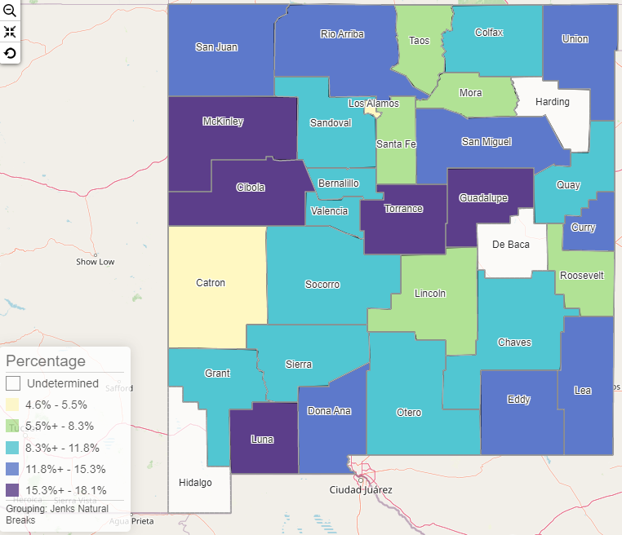
Diagnosed Diabetes By County of Residence
2018-2020 Weighted Age-adjusted Estimates
Notes:
The prevalence of diagnosed diabetes varies by county. The counties with the lowest prevalence were Los Alamos, Catron, Mora, Santa Fe, Roosevelt, Taos, and Lincoln. The counties with the highest prevalence were McKinley, Cibola, Torrance, Luna, and Guadalupe. Even with three years of data, there was a great deal of overlap in confidence bounds. Estimates for three counties, De Baca, Harding, and Hidalgo, were suppressed due to inadequate sample size.

