Slide 1

Dancing with Data:
Many Ways to Move and Groove

Slide 2
Introductions
Lynnzy McIntosh
  Vice President of PAC Software, Inc. the developers of Workshop Wizard, and a Contractor to the New Mexico Department of Health

Slide 3

Workshop Wizard
Notes:
Where Lynnzy spends most of her time. Providing technical assistance and training on Workshop Wizard. WW is responsible for data management, referral tracking, and reporting for 16 states including New Mexico.
Came out of our work in implementing multiple evidence-based programs in Colorado.

Slide 4
Objectives
Recognize Paths to Health New Mexico: Tools for Healthier Living (P2HNM) providing multiple prevention and self-management programs.
Foster greater understanding of the benefits of using P2HNM for connecting health care to community- based programs.
Increase your knowledge and comfort level in making referrals to community-based programs.
Engage and enjoy the referral and feedback process.

Slide 5

Picking up the Beat

Slide 6
Public Website and Marketing
The Paths to Health New Mexico website was launched in August 2018. The website is designed to:
  Share information about Paths to Health New Mexico and the prevention and self-management programs that are available to New Mexicans
  Provide a means for healthcare professionals to refer patients
  Enable New Mexicans to find information about classes and self refer
  Provide materials for class leaders to download and use to promote classes

Slide 7
Public Website and Marketing
  Tour of Paths to Health New Mexico website

Slide 8
Public Website Analytics
2018
Total Users (annualized) 1,388
Pageviews (annualized) 8,652
2019
Total Users 2,918
Pageviews 13,824
2020
Total Users 3,307
Pageviews 12,997
2021
Total Users 5,373
Pageviews 14,323
2022
Total Users (Annualized) 5,628
Pageviews (Annualized) 15,288

Slide 9
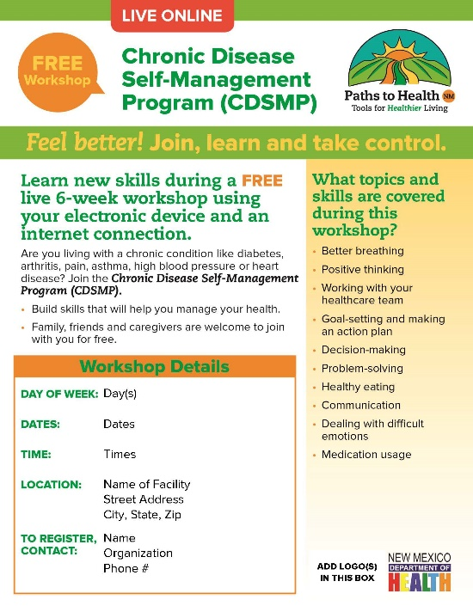

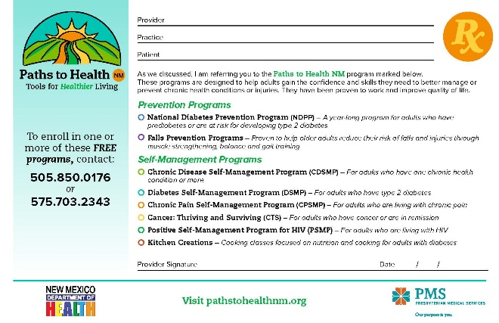
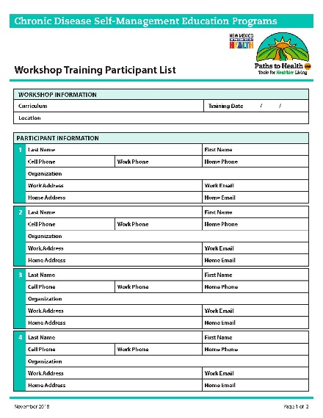

Public Website and Marketing

Slide 10
Partners in Care Statewide
Adelante Development Center, Inc. All Nations Wellness Center Chavez County Extension Services Christus St. Vincent Medical Center City of Albuquerque, Dept. of Sr Affairs CWA Strategic Communications, Inc. Comagine Health DeBaca Family Practice East San Jose Elementary School Enlace Comunitario First Choice Community Healthcare Holy Cross Hospital La Casa Family Health Center La Mesa Elementary School Las Clinicas Los Alamos National Laboratory Lovelace Health System | Montañas del Norte Health Ed Center NCEDD Non Metro AAA New Mexico Department of Health NM Health Information Collaborative NM Primary Care Association NMSU Cooperative Extension Service Northern Navajo Medical Center Presbyterian Healthcare Services San Felipe Pueblo San Juan Regional Medical Center Sandoval County Southern Area Health Education Center Taos Pueblo YMCA, Albuquerque and Los Alamos UNM Hospital Western Sky Community Cares Zuni Pueblo

Slide 11
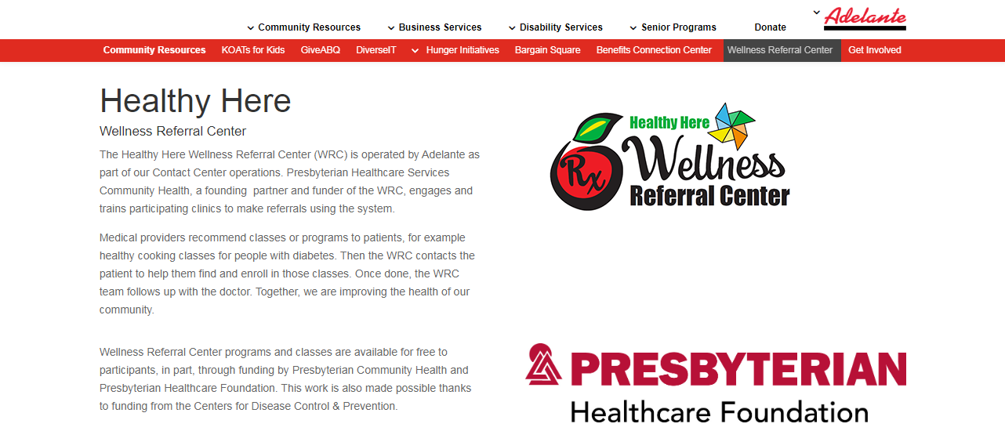
Wellness Referral Center

Slide 12

Learning New Steps

Slide 13




What all is Included

Slide 14
Self-Management
Chronic Disease Self-Management Program
Chronic Pain Self-Management Program
Cancer: Thriving and Surviving
Diabetes Self-Management Program
Positive(HIV) Self-Management Program
Kitchen Creations

Slide 15
Self-Management
Tomando Control de su Salud
Programa de Manejo Personal de la Diabetes
Vivir Más Sano con VIH
Programa de Manejo Personal del Dolor Crónico
YMCA Blood Pressure Self-Monitoring Program
Walk With Ease

Slide 16
Falls Prevention
Tai Chi for Arthritis for Falls Prevention
Tai Ji Quan: Moving for Better Balance
Matter of Balance

Slide 17
Diabetes Prevention
National Diabetes Prevention Program
Medicare Diabetes Prevention Program

Slide 18
With Referrals
Diabetes Self-Management Education and Support (DSMES)
Otago

Slide 19

Why Make a Referral?

Slide 20
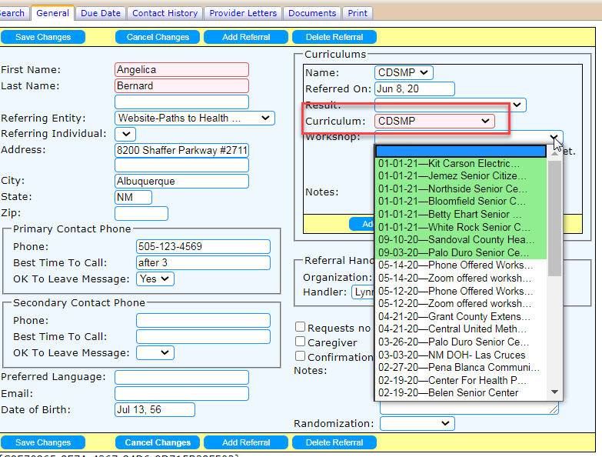
Data Behind the Scenes

Slide 21
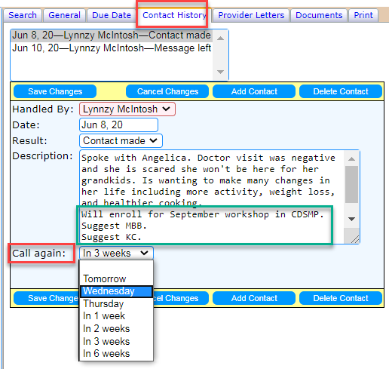
Referral Progress Notes

Slide 22
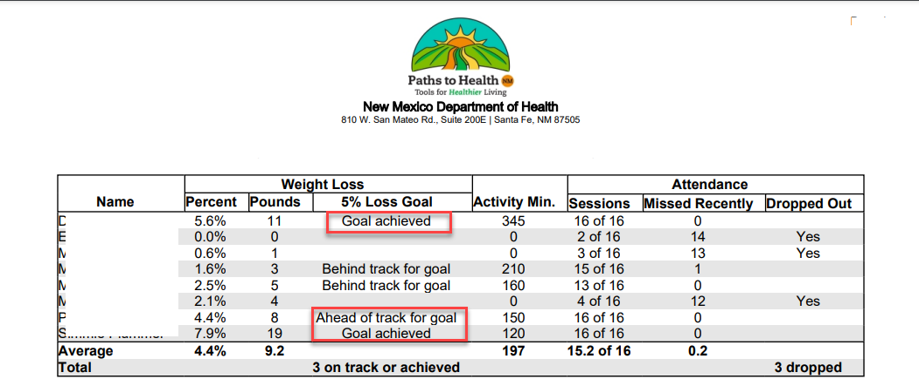
Data and Feedback

Slide 23
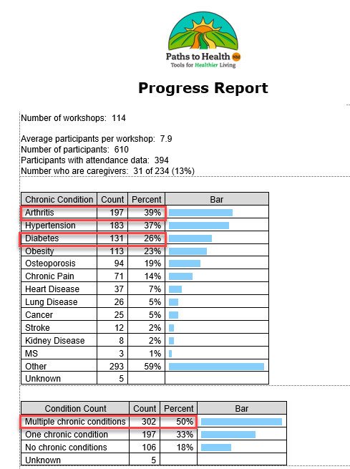
Data and Feedback

Slide 24
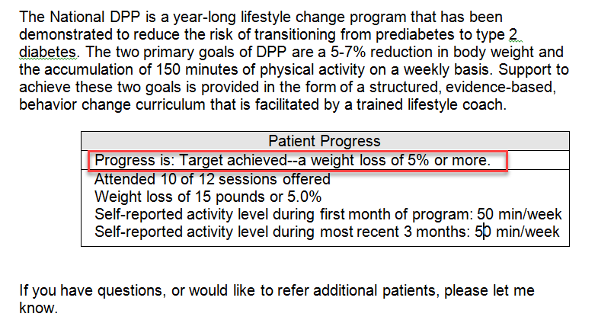
Clinician Data

Slide 25

Practicing Your Routine

Slide 26

The 10 Second Referral

Slide 27
They Might Say No

Slide 28
Referral Process
Health care providers receive info on self-management support including workshops in multiple curriculums.
Practice agrees to making referrals through Workshop Wizard to Paths to Health New Mexico.
Demographic reports, pre-post data comparisons generated by through Workshop Wizard .
Clinician and team provided rack cards, tips on referral messaging, handouts for patients, waiting room materials, talking points for all staff.
Talking points available for provider and staff to discuss progress with patient.
Referred patient is contacted by the Wellness Referral Center. Contacts and enrollment is tracked. Attendance and demographics data entered.
Clinician and/or Staff discuss workshops and Patient agrees to referral.
Provider Feedback Letters are generated to referring entity to automatically provide progress reports .
Workshop Wizard software receives referral and sends confirmation to the referring entity.
Referral sent via established protocols: fax or secure message generated through EMR.
Designated staff generates referral. Referral is documented in EMR.

Slide 29
Accessing P2HNM Programs
Using your existing referral process
  EMR
  Fax
PathstoHealthNM.org
  Self-Referral numbers to Wellness Referral Center 505-850-0176 or 575-703-2343

Slide 30
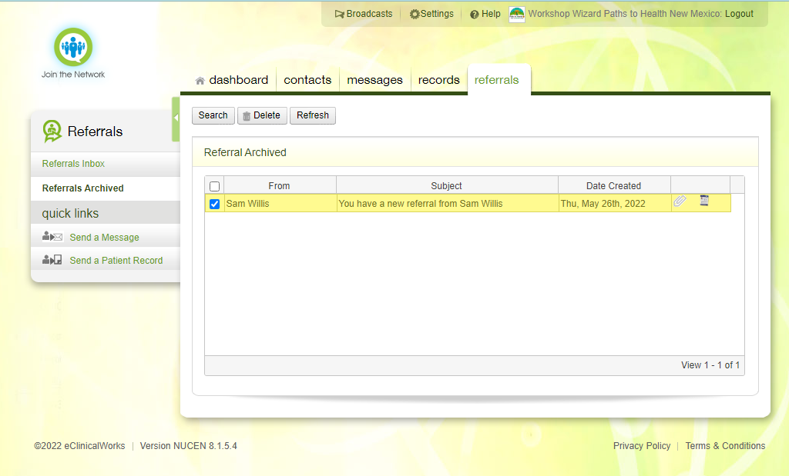
eClinicalWorks

Slide 31
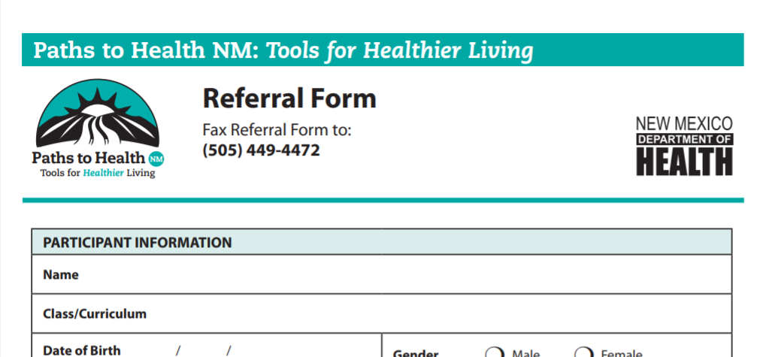
Accessing P2HNM

Slide 32

Relax and Trust

Slide 33
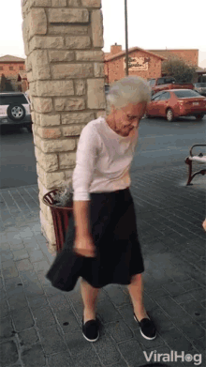
Enjoy the Dance

Slide 34

Next Steps
Send a Chat right now!

Slide 35
Contact Info
PathstoHealthNM.org
505-850-0176 and 575-703-2343
Lynnzy@WorkshopWizard.net
Lynnzy.McIntosh@Direct.PacSoftware.NMHIC.org

Slide 36


