Slide 1
Nutrition Across the Lifecycle –
An Applied Model of Nutrition Education at Taos Pueblo
New Mexico Diabetes Advisory Council Meeting, Albuquerque, NM
September 6, 2019
Paula Szloboda, RN, CDE®, BC-NC, therapeutic chef

Slide 2
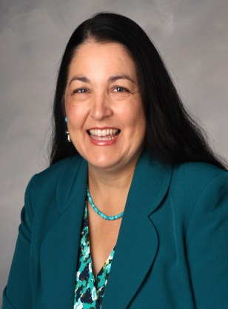
NiIt’s Nice to Meet You!
Registered Nurse and Certified Diabetes Educator®
Masters Holistic Health Education with a specialization in Holistic Nutrition (Functional Medicine Model)/MBA
Therapeutic Chef
Board Certified Nurse Coach – RN Health Coach certified by American Holistic Nurses Credentialing
Professor of Integrative Health and Nutrition
Program Development
Community Nutrition and Economic Development Programs
Academic Program and Online Learning Platforms
Corporate Program Development - Virtual Diabetes Coaching Program
I currently serve as Nutritionist for Taos Pueblo, Division of Health and Community Services

Slide 3
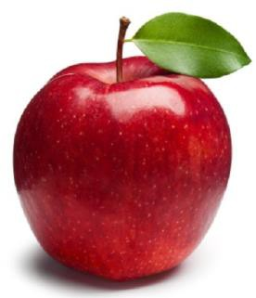
My Nutrition Philosophy
Food forms the fiber of our being.
Food is more than nutrition.
Food is one of the ways that we directly interface with our environment.
Food can heal the body.
What is your nutrition philosophy?

Slide 4
A Blended Model of Coaching and Consulting
Meet client where the client is now
Acknowledge client’s expertise in knowing how their life works
Start where the client is open to beginning
Find the actions that the client is already engaged in that support client’s goal, and build on those actions
People need 3 things to have sustainable success with change
1. Autonomy (Choice) 2. Confidence (in their ability to make change) 3. Support (this is where you and I come in!)

Slide 5
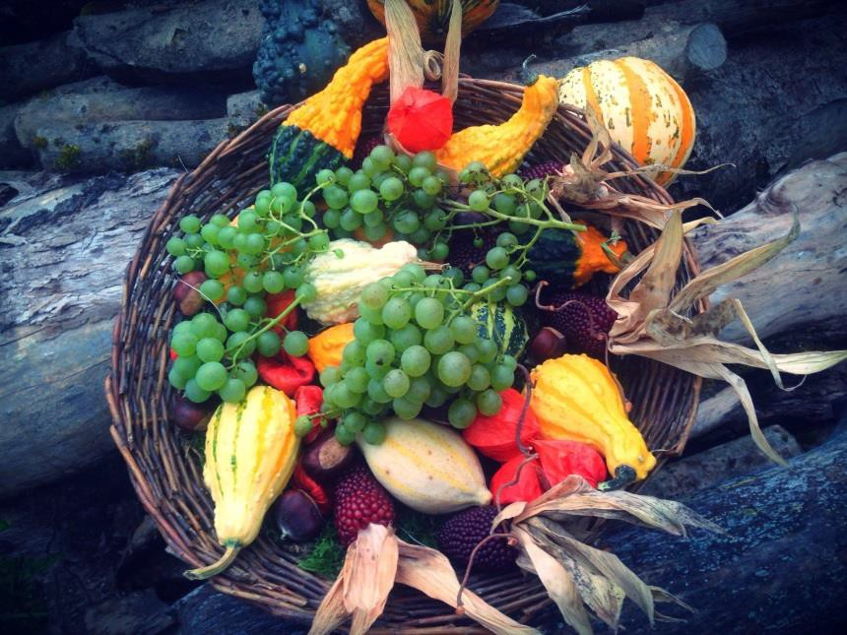

Nutrition Made Simple
Grown on a plant?
OR
Made in a plant?

Slide 6
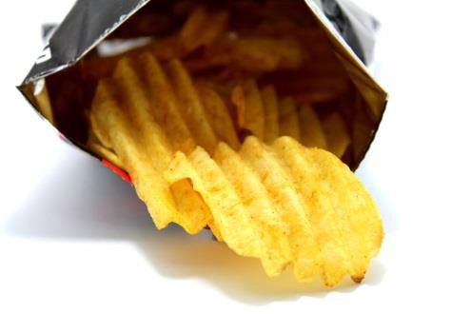
Food vs. Processed Food Products
Whole Food has…
Fiber
Vitamins
Minerals
Plant healing- compounds (phytonutrients)
Processed Food Products…
Often lacking in fiber
Chemically-created
vitamins and minerals
Unhealthy fats
Added sugar and sweeteners

Slide 7

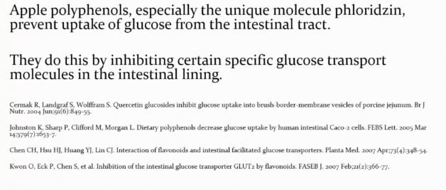

Plants contain healing compounds. Many of these compounds we do not know very much about yet.

Slide 8
Why is it important to include everyone in your Nutrition Education program?
Everyone at any age can benefit from improved nutrition
When everyone has information and support for making changes, people can support one another as they embrace change
Children can encourage and teach parents
The wisdom of Elders is shared with Youth and families
Synergy occurs when nutrition education messages are repeated throughout the community

Slide 9
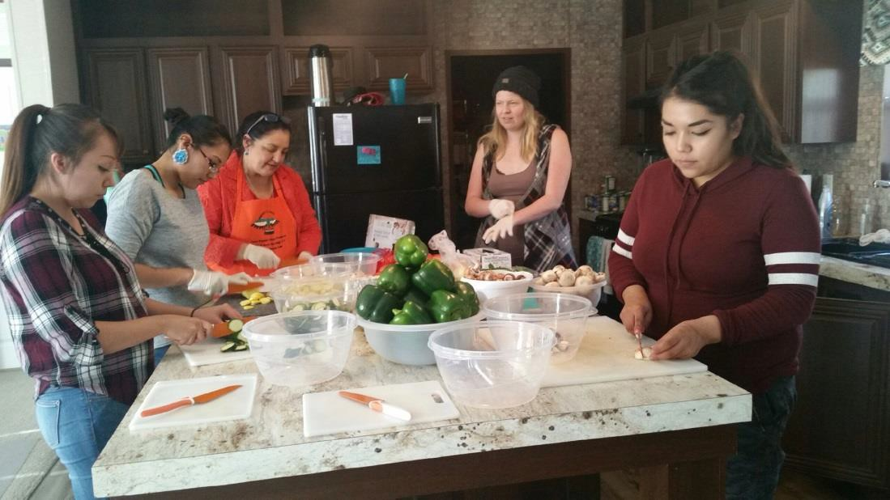
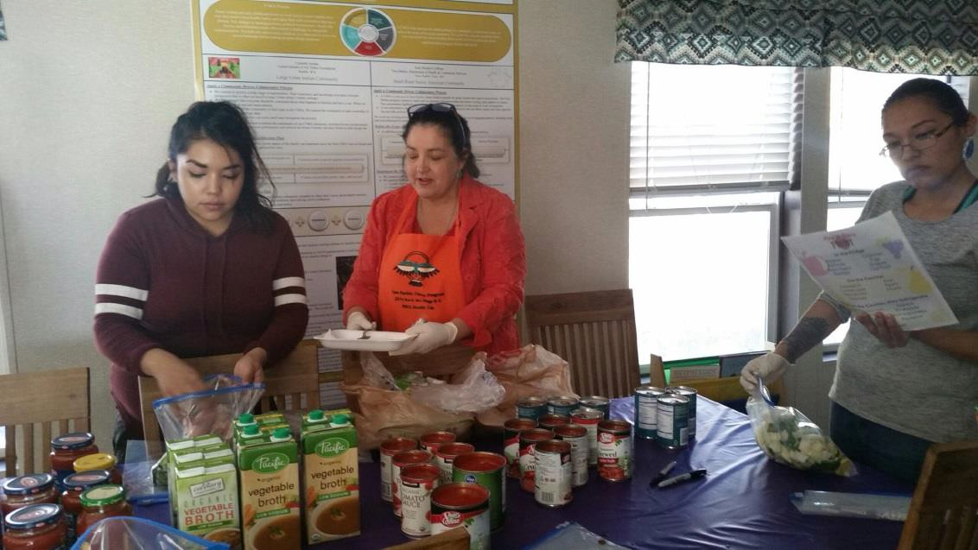
Tiwa Babies Collaborative Cooking
Class
Class participants made three meals for their families and they received a crockpot.
This was a collaborative class held with Taos Children’s Trust Fund.

Slide 10
Nutrition Education for Young Families
4 concepts | 4 activities | 4 skills | 4 recipes
Food forms the fiber of our being – supporting healthy growth and development (pregnancy support) | Make-it and Take-it foods in a mason jar | Meal Planning | Happy Hummus
Making your own food makes healthy food affordable | Cooking from the garden | Crock pot cooking and freezer meals | Vegetarian Lasagna Soup
Preventing picky eating in children | Making baby food and teething biscuits | Label Reading | Sweet Potato Turkey Chili
Make healthy snacks | Making healthy snacks for expectant moms and toddlers | Navigating WIC | Strawberry Oatmeal Bars

Slide 11
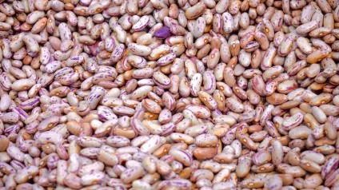
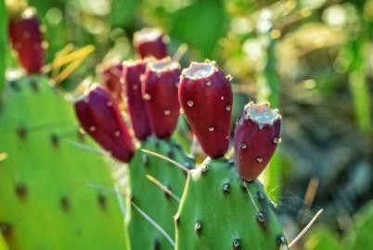
Tips for Healthy Food Shopping on a Budget
Buy foods that are in season and shop the sales.
Buy whole foods and season them yourself.
Buy in bulk when it makes sense to do so. Consider going
in together with a friend or family member
for added purchasing power.
Prepare and portion food when you get home from shopping.
Cook your own food. Freeze leftovers and make sure to
mark what is in the container.
Grow some food.
Look for food that is growing wild around your home
(wild plums, apples, cacti, greens, pinon)

Slide 12
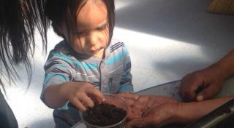
Taos Pueblo Head Start
Planting seeds begins early!

Slide 13
Nutrition Education for Young Children
4 concepts | 4 activities | 4 skills | 4 recipes
Where does food come from? | Growing seeds and plants | Planting seeds | Rainbow Salad
Introduction to the “Magic 8” foods cultivated in the Americas | Puppet shows and story books | Caring for plants | Spaghetti Squash
Skill building for building a palate for healthy foods | Food detective activities | Using senses to explore food | Pear-apple sauce
What does food do for you? | Making a recipe | Simple food prep skills – mixing, etc | Simple smoothies

Slide 14
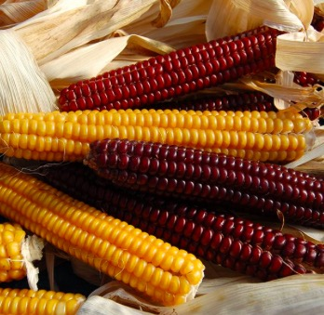
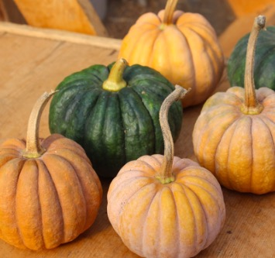
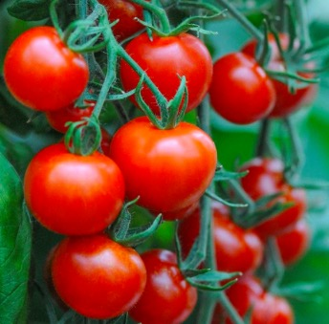
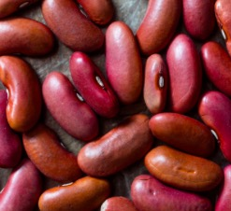
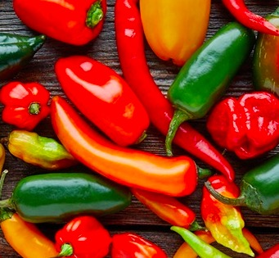
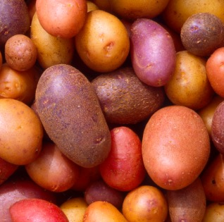
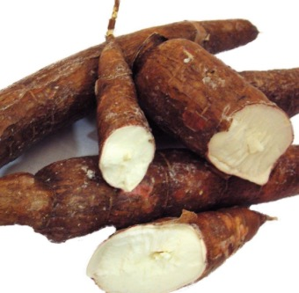
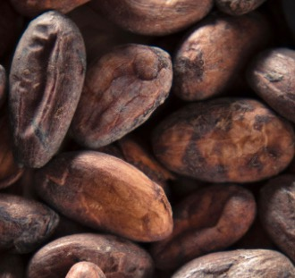
The “Magic 8” Pre-Contact Foods cultivated by Indigenous Peoples of North and South America
Corn
Beans
Squash
Chiles
Tomatoes
Potatoes
Cassava
Cacao
From the work of Dr. Lois Ellen Frank – Native Cooking for Kids

Slide 15

Food Detectives
C.H.I.L.E. (Child Health Initiative for Lifelong Eating and Exercise)
Lessons focused on exploring food with all senses (sight, touch, smell, taste, sound)
Connect food to plants
Steps:
  Look at the plant, fruit/vegetable, note the color, texture, and aroma of the fruit/vegetable. Does it have a sound?
  Cut it open. Are there seeds? What does the inside of the fruit/vegetable look like? What does it smell like? How does it taste?

Slide 16
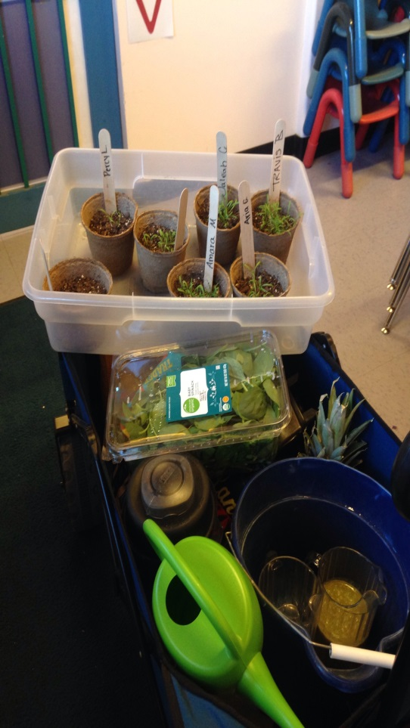
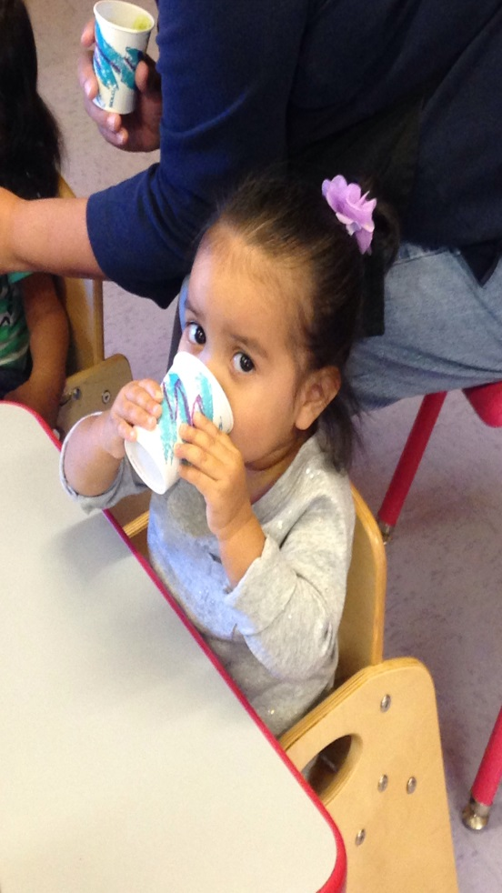
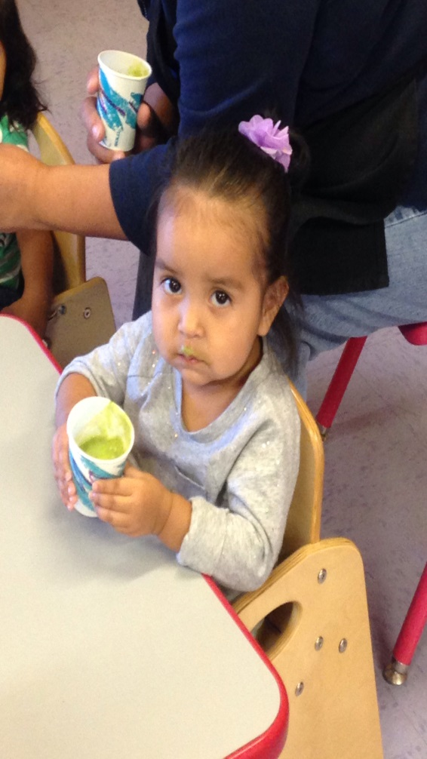
Grow It – Make It – Taste It

Slide 17
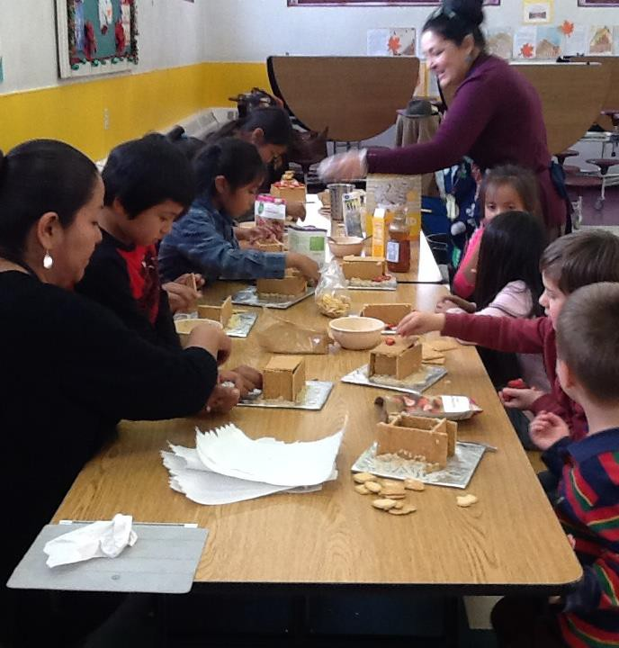
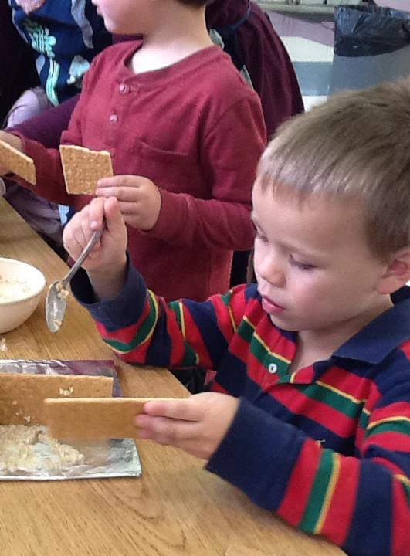
After School Cooking
Taos Day School

Slide 18
Nutrition Education for Youth
4 concepts | 4 activities | 4 skills | 4 recipes
What are nutrients? Where do we find them? What do they do? | Learning how to balance flavors in food | Measuring and preparing ingredients | Homemade pizza and pizza sauce
Native foods – the Magic 8 | Native Cooking for Kids | Reading and writing recipes | Pickled Watermelon Rinds
Food vs. Processed Food Products | Making a healthy meal – Building a plate | How to read food labels- comparing food labels and finding sugars | Homemade pancake mix
Growing Your Own Food: Seed saving/seed germination | Gardening | Working with tools – knives in the kitchen and gardening tools (age-appropriate) | Fruit-infused water

Slide 19
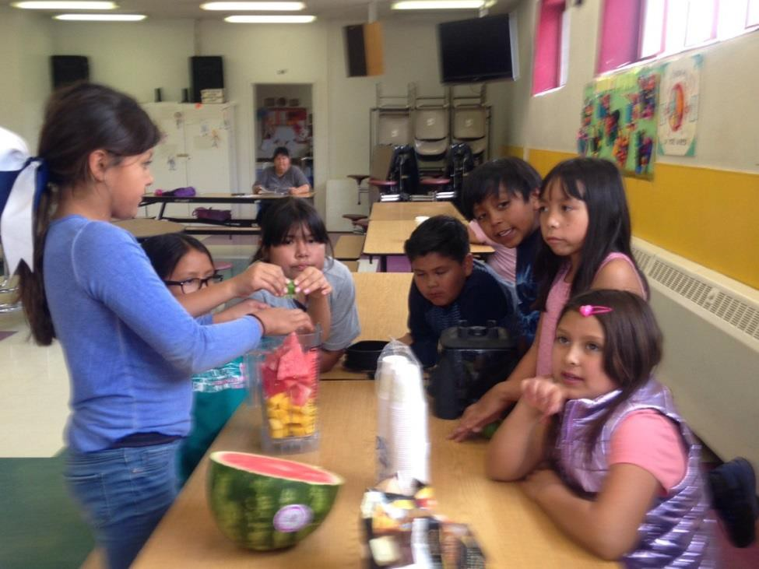
Students learn by using all of their senses as they explore the foods that are being used in the recipes.
When we made pumpkin hummus the students listened to the sound of the garbanzo beans as they shook the cans.
When kids make the food, and grow their own food, they are much more likely to try it.
Combining a known and favorite food like pumpkin with a
not-so-familiar or new food, also encourages kids to try it

Slide 20
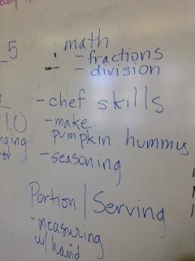
Students reflect on their learning.
In addition to nutrition, students learn problem-solving skills, and math, reading and language skills are strengthened.
Adaptations for younger students include:
Reading recipes aloud
Writing recipes
Drawing – make a plate, eating the rainbow

Slide 21

Curricula Used in Taos Pueblo
Nutrition Programs
C.H.I.L.E. – Child Health Initiate for Lifelong Eating and Exercise
Native Food For Life (Physicians Committee for
Responsible Medicine)
“Cooking with Kids”
Native Cooking for Kids (Dr. Lois Ellen Frank)
Feast for the Future (Johns Hopkins Center for American Indian Health)

Slide 22

Steps for Adapting an existing
curriculum
Evaluate the possible choices by reviewing existing curricula.
Open a conversation with the stakeholders. Discuss the possibilities. Get a clear picture of their needs and explore capacities for the program.
Ask about the end result and determine what we want participants to take away from the program.
Set a time and date to begin, and prepare.
Consider doing a pilot program or a one-time event to learn.
After the program is underway, evaluate what is working and where adjustments are needed.
Get Feedback.
Make adjustments as needed.

Slide 23
Nutrition for Adults Making Lifestyle Changes
4 concepts | 4 activities | 4 skills | 4 recipes
Food can heal the body | Making wraps, bowls, salads – meal preparation with a weekly prep day | Meal Planning | Vegetable dipping sauces
Love Your Liver | Mindful Eating | Making healthy food from scratch | Green Drinks
Processed Food Product vs. Food | Fast food redefined | Label Reading | Salad Dressing from scratch
Self-care and making your own food | Taming a sweet tooth by making your own desserts | Choosing the type and amount of sweetener | Homemade chocolate truffles

Slide 24
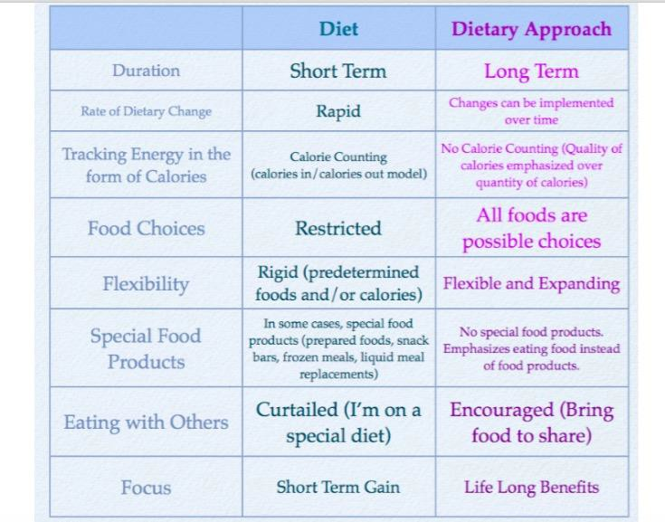

Slide 25
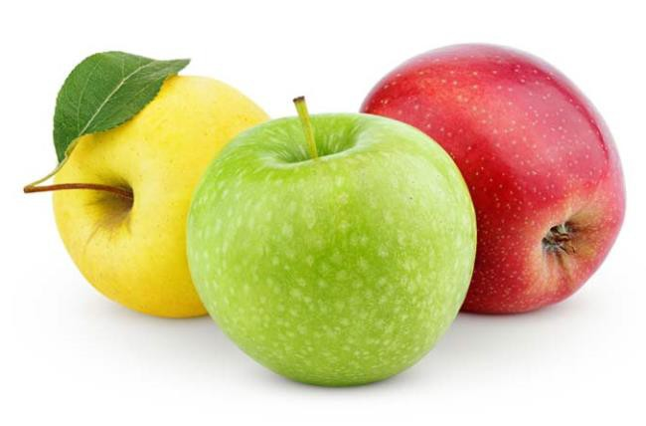
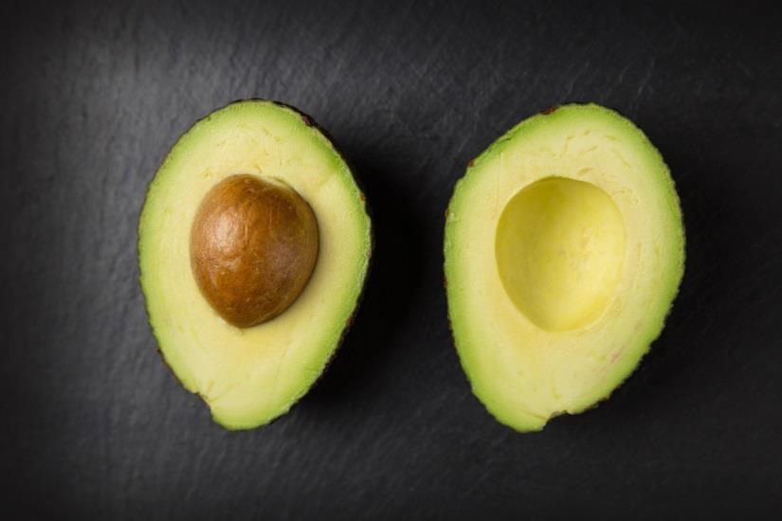
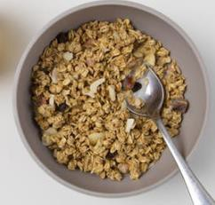
Fast Food Redefined – A Challenge
Fruit and vegetables in their whole form.
Food that is made from other meals including soups, stews, and salads.
Oatmeal, simple sandwiches, plain yogurt with fruit.

Slide 26

Is your tuna salad a dessert?
Food labels must list ingredients in order of largest quantity first
If sugar or a sweetener is listed as one of the first three ingredients (not counting water) then sugar is one of the primary ingredients
4 grams of sugar = 1 teaspoon of sugar

Slide 27
Quick Label Reading
What is the serving size? (top of the label)
What is the fat content?
What is the transfat content? It should be zero.
How much carbohydrate? How much fiber?
Look at the ingredients list. If sugar/ sweetener is listed as one of the first three ingredients, consider the food to be a dessert.
Does the food have any vitamins /minerals?

Slide 28
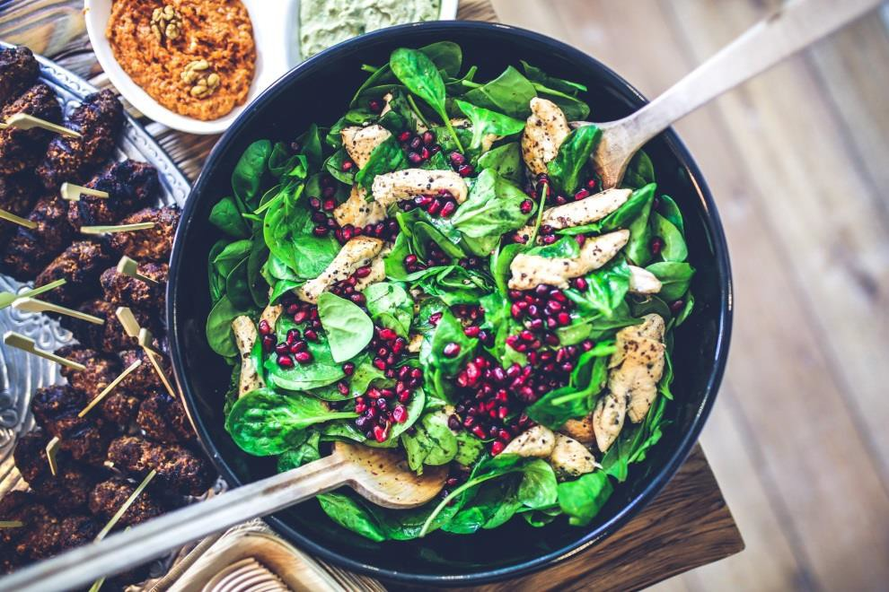
American Association of Diabetes
Educators Self-Care Behaviors™
Healthy Eating
Being Active
Monitoring
Taking Medication
Problem Solving
Healthy Coping
Reducing Risks

Slide 29
Nutrition Education for Seniors
4 concepts | 4 activities | 4 skills | 4 recipes
Food influences function – energy and organ function (kidneys, blood sugar balance, heart health) | Making foods that support immune function, and organ function | Using herbs and spices as a low-sodium alternative to salt New foods/ familiar textures | Turmeric anti-inflammatory drink
Supporting healthy digestion | Making food together | Label reading | Fire Cider
Better Blood Sugar | Collaborating with Fitness Program – Ojo Caliente | Flavoring food to please your palate | Pumpkin and Squash Soup
Building strong bones | Intergenerational gardening and cooking | Recipe sharing | Corn Chowder/ Bone Broth

Slide 30

Blood Sugar too High?
Here are some things to look at involving food and
eating:
  Ate more food?
  Ate out or special occasion?
  Snacking or nibbling on food?
  Drank alcohol?
  Type of food?
Source: The Art and Science of Diabetes Self-Management Education Desk Reference,
Third Edition, American Association of Diabetes Educators p. 217

Slide 31
Factors that Influence Senior Nutrition
Capacity for chewing and swallowing
  Prepare food so that it is softer, and easier to chew and swallow
  Assess whether referral to dentist would be helpful
Lack of appetite
  Prepare nutrient-dense food - every bite counts!
  Zinc can stimulate appetite (pumpkin seeds are a great source of zinc)
  Congregant meals and meals shared with others can stimulate the appetite

Slide 32

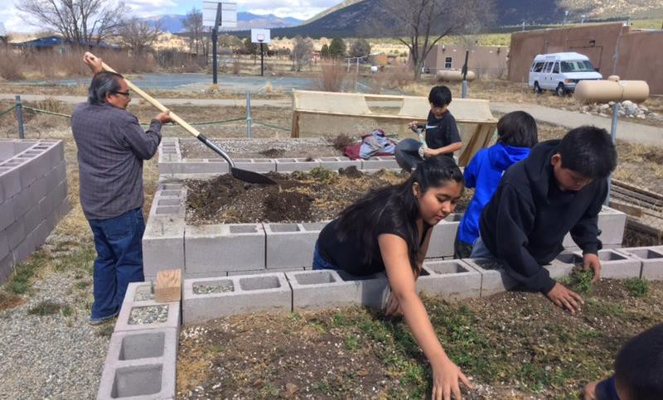
Intergenerational Gardening and
Cooking
During the Spring break, students from the C.O.R.E. (Community, Outreach, Resiliency, Empowerment) Youth Group, which included Taos Day school students and middle- school students from Taos Pueblo, came together with Seniors at the Lillian Romero Senior Center to cook and garden together. This was a service learning activity for the students and a time to build relationships with elders

Slide 33
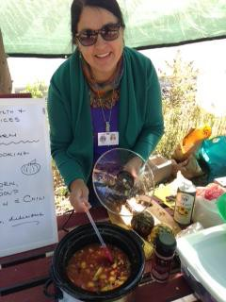
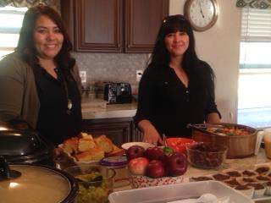
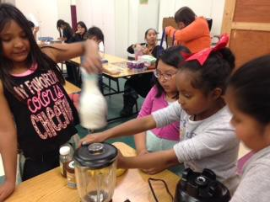
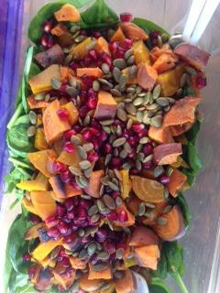
Reaching out to the Community
Successful strategies….
Create collaborative events that bring together several programs to build participation and make the work easier and more fun. The nutrition program collaborates with Taos Pueblo Fitness, the Lillian Romero Senior Center, Tiwa Babies, tribal schools, and social services.
Have fun and make it a goal for all to have a good time.

Slide 34
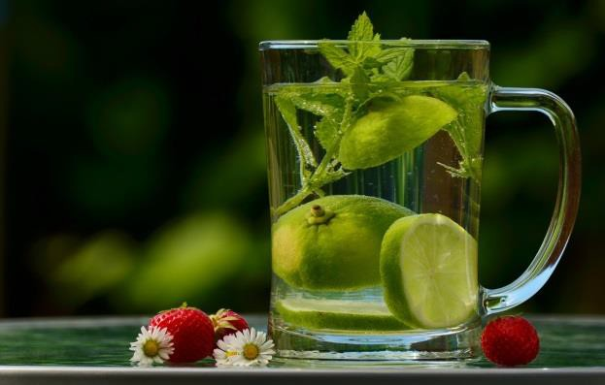
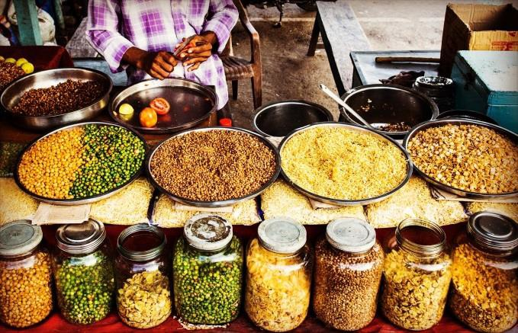

Other strategies that have been
successful…
Include healthy beverages at every event.
Include lots of variety. If people can choose from a variety of healthy food, they can create the flavors they enjoy, and they can customize the food to fit with their preferences. Also, it’s fun!
Always make it fun and engaging. Hands-on activities show that making healthy food is simple and easy and enjoyable.

Slide 35
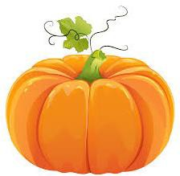
Share it to Support and Inspire
Tiwa Times Newsletter
  Highlight nutrition activities happening in the
community
  Photos of community members engaging in nutrition activities – cooking and gardening
  Nutrition information
  Recipes

Slide 36
Resources
Nutrition.gov
www.cms.gov/Medicare/Coverage/InfoExchange
The Art and Science of Diabetes Self-Management Education Desk Reference, Third Edition, American Association of Diabetes Educators, 2014
www.nutritionadvocacy.org
Clinical Nutrition: A Functional Approach, Bland, et.al,
The Institute of Functional Medicine, 2004

Slide 37
Thank You!
For Additional Recipes or Nutrition Information:
Paula Szloboda, RN, CDE®, BC-NC, therapeutic chef
Nutritionist, Division of Health and Community Services, Taos Pueblo
707 319-9839 cell phone, 575 758-7824, ext. 104 office line
pszloboda@taospueblo.com
healthychefpaula@gmail.com

