Slide 1
Importance of Choice In Formulating Care Plans for Young People and Diabetes Technology
Jessica Kirk, MSN, RN, CPN, CDE
Nurse Manager, Endo ECHO

Slide 2
Disclosures
Tandem Pump Trainer (TPT) for Tandem Diabetes
Certified Pump Trainer (CPT) for Insulet Corporation

Slide 3
Objectives
Distinguish patients appropriate for continuous glucose monitoring and insulin pump use
Describe the importance of providing people with diabetes choice in regards to technology
Identify different diabetes technology options on the market

Slide 4
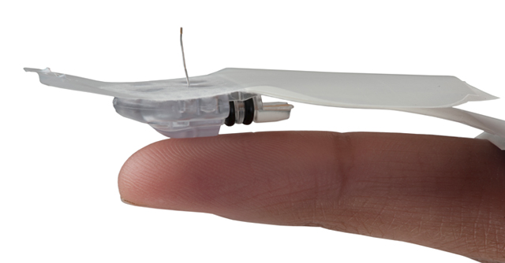
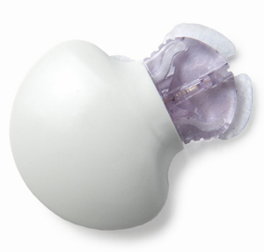
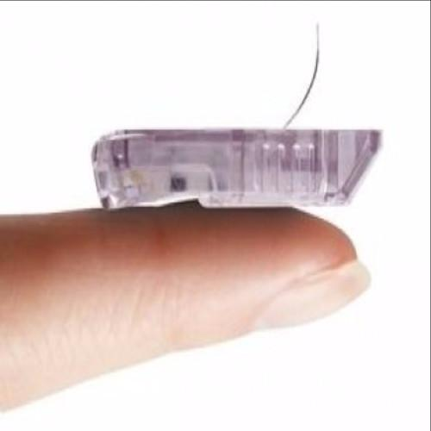
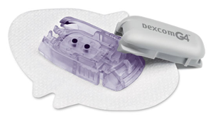
Continuous Glucose Monitoring
Subcutaneous sensor reads interstitial fluid glucose every few minutes
Attached transmitter sends values to receiver
Receiver displays glucose values in real time and provides trend arrows
Trend arrows show how quickly glucose is changing
Sensor is changed by patient every 6-7 days

Slide 5
Why CGM?
Fear of hypoglycemia is recognized as the number one barrier to achieving good glycemic control²
Hypoglycemic Unawareness
Worry about lows leads to avoidance & suboptimal control¹
Can reduce a1c and glycemic variability
Improved quality of life
Irvine, Cox & Gonder-Frederick, 1992, Health Psychology 11(2): 135-138
Graveling & Frier, 2010 , Diabetes Metab, 36 Suppl 3: S64-74
Notes:
Can happen within 5 years of dx¹
Affects more than 20% of people with T1DM⁴

Slide 6

158 T1D patients on insulin injections
Mean age 48 yrs, baseline A1c 8.6%
Randomized to CGM vs usual care
Notes:
2 JAMA reports in January…

Slide 7
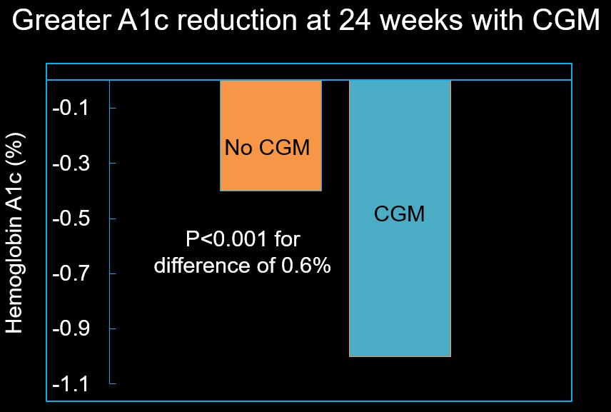

Slide 8
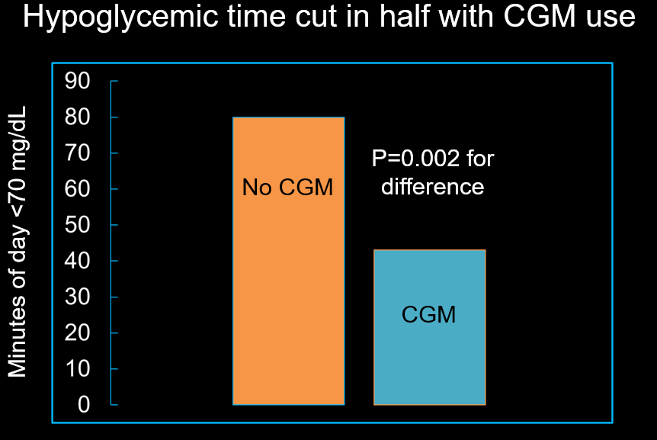

Notes:
Also less glycemic variability in CGM group…determined per blinded CGM…

Slide 9
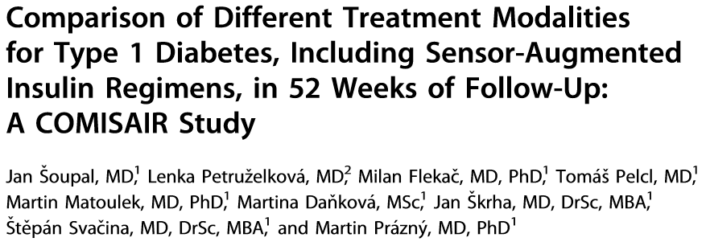
65 T1D patients; mean age ~35 yrs, baseline A1c 8.3%
Non-randomized, prospective trial of T1D patients referred to diabetes center on multiple daily injections of insulin (MDI) and NO CGM → assigned to various treatments per patient preference
Diabetes Technol Ther 2016;18(9):532-8.
Notes:
Real life sample of convenience…

Slide 10
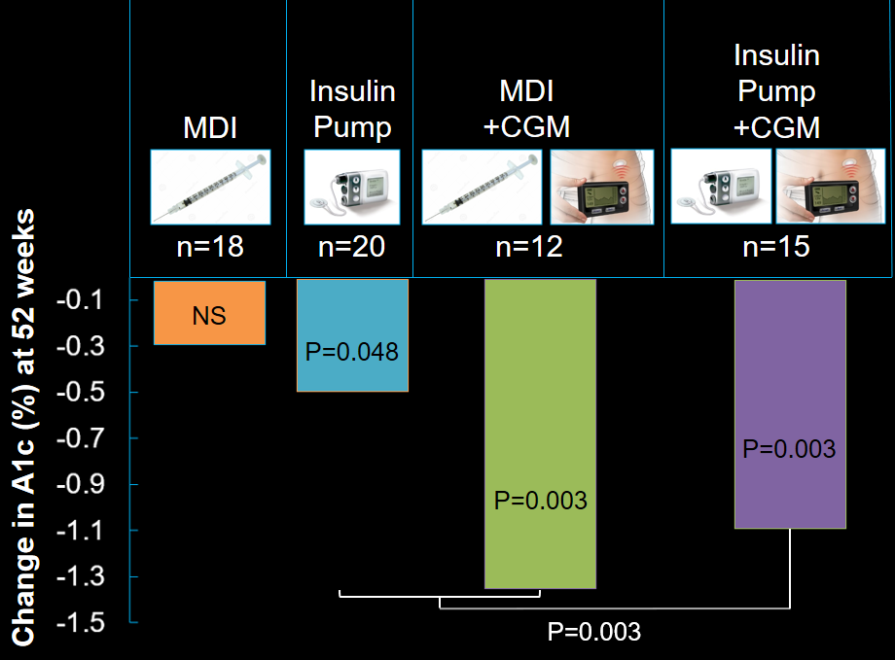
Diabetes Technol Ther 2016;18(9):532-8.
Notes:
4 fingerstick BG per day in non-CGM groups…

Slide 11
What CGMs Are Out There?
Dexcom G5
Only stand alone CGM on market
FDA approved to replace finger sticks for treatment decisions
Covered by Medicare
Medtronic Guardian 3
Integrated with Medtronic 670g insulin pump
Medtronic Enlite
Integrated in Medtronic 630g insulin pump
Dexcom G4
Integrated in tslim G4 insulin pump
Integrated in Animas Vibe insulin pump

Slide 12
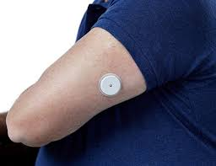
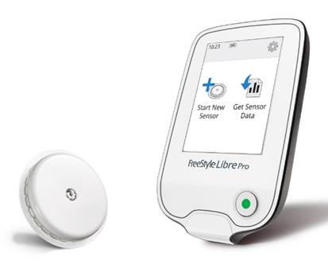
Freestyle Libre Pro
Professional CGM
Blinded to the patient
14 days of data

Slide 13
Indications for CGM
A1c above goal
Pre-conception
Pregnancy
History of severe hypoglycemia or hypoglycemia unawareness
Glucose variability
Patient willingness to calibrate sensor with finger sticks
Basal/Bolus Insulin Therapy

Slide 14
Documentation Tips
Hypoglycemia unawareness
History of severe glycemic excursions
Noctornal Hypoglycemia
Recurring severe hypoglycemia
Hypoglycemia requiring third party assistance
Dawn phenomenon where fasting often exceeds 200mg/dl
Day to day variations in work schedule, meal times, or activity level which cofound the degree of regimentation require to self-manage
Completed comprehensive diabetes education
Demonstrated ability to self-monitor blood glucose levels
Motivated to achieve glycemic and maintain improved glycemic control

Slide 15
Pump Therapy/CGM Integration
Tslim G4
Animas Vibe
Medtronic 670g
Medtronic 630g

Slide 16
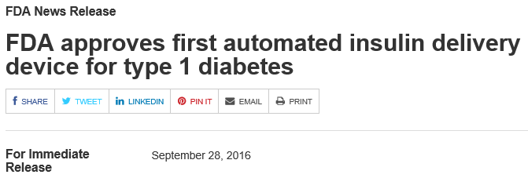
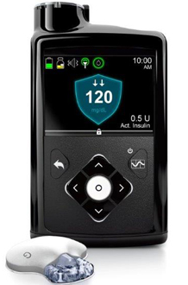
Medtronic MiniMed 670G Hybrid Closed Loop System
Available Spring 2017
Automated adjustments in subcutaneous insulin basal rates based on CGM readings

Slide 17
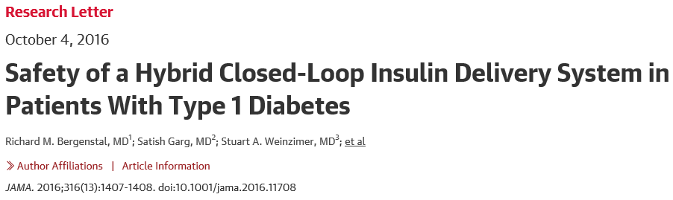
124 T1D patients; mean age 38 yrs, baseline A1c 7.4%
Multicenter, uncontrolled trial
2 week run-in period (Medtronic pump only)
3 month study period (Medtronic automated pump/CGM MiniMed 670G system)

Slide 18
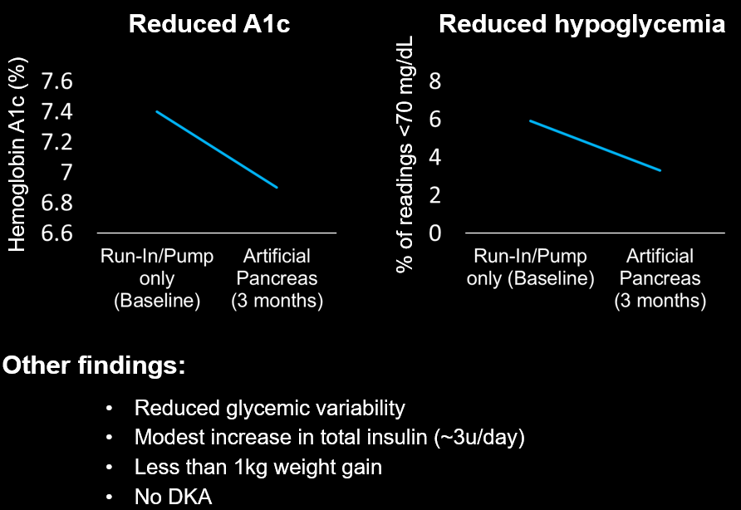
Early data suggest hybrid closed loop technology is safe
but long term RCTs are needed
JAMA 2016;316(13):1407.
Notes:
Patients already had reasonable control at baseline…

Slide 19
Indications for Pump Therapy
A1c not at goal despite best MDI efforts
Variable blood glucose swings
Severe or unpredictable hypoglycemia
Dawn phenomenon
Pre-conception planning/ pregnancy
Extreme insulin sensitivity (or resistance)
Gastroparesis
Erratic schedules/ rotating work shifts
Desire for flexibility
Insulin pump therapy: guidelines for successful outcomes, The American Association of Diabetes Educators. 2009

Slide 20
Who is a “good” pump candidate?
Patient who perceives self management impedes pursuit of personal or professional goals
A1c greater than 7.0-7.5%, accompanied by frequent hypoglycemia
Hypoglycemia events requiring third party assistance OR Interfering with work, school, or family obligations
Frequent and unpredictable fluctuations in blood glucose levels
Patients who have the competence to perform basic diabetes self-management behaviors
Insulin pump therapy: guidelines for successful outcomes, The American Association of Diabetes Educators. 2009

Slide 21
Advantages of Pump Therapy
No more “4+ shots a day”
Convenient insulin dosing- basal and bolus
More precise insulin dosing and accurate delivery
More predictable insulin action
Often helps improve A1c
Allows for lifestyle flexibility
Eating schedule and food choices
Activity
Travel
Can help reduce wide blood glucose swings-high or low
Insulin pump therapy: guidelines for successful outcomes, The American Association of Diabetes Educators. 2009

Slide 22
Disadvantages of Pump Therapy
Requires problem solving skills
Higher risk of Diabetic Ketoacidosis (DKA)
Expensive
Requires training and mastering new skills
Some people may feel “chained to diabetes”
Requires planning for supplies and equipment maintenance
Improved blood sugars may = weight gain
Insulin pump therapy: guidelines for successful outcomes, The American Association of Diabetes Educators. 2009

Slide 23
Pumps on the Market
Tslim X2
Tflex
Omnipod
Animas

Slide 24
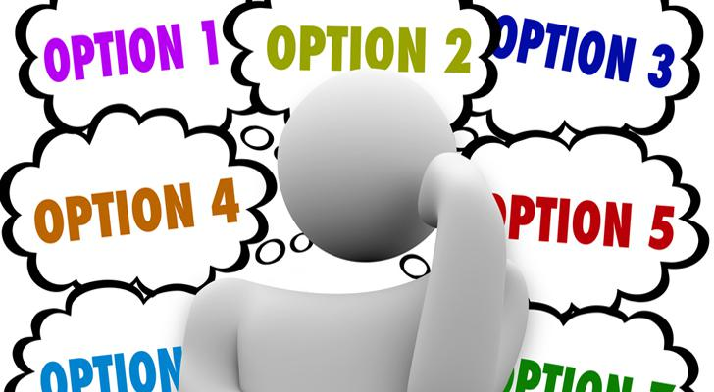
How Do We Pick?

Slide 25

We don’t

Slide 26
Presenting Therapy to Young Adults with Diabetes
T1D young adults strongly feel their providers tell them what to do
Respond adversely to authoritarian style communication from healthcare professionals
Negative emotions associated with these interactions
Scholes et. al, 2013

Slide 27
Patient-Centered Care
Ask the patient:
What is important to you?
What are your goals? Health and life goals?
Identify and respect:
Differences
Values
Preferences
Expressed needs
Decision making must be mutually attained
Patients MUST be listened to and not dictated to
Patient chooses therapy and device after being presented all options
Patient has a say in care plan
(Rubenfeld & Scheffer, 2010)

Slide 28
Planning Care for Young People with Diabetes
Consider all options:
Continuous Glucose Monitoring
Blood Glucose Monitoring
Multiple Daily Injections
Insulin Pump Therapy
Consider Possible Payer Barriers and Patient Safety
Present All Options to Patient: Explore Pros and Cons Together
Give the patient the power to choose

Slide 29

Thank you

